Slide 1
Network Topologies
Dr. R. Prashanth

Slide 2
Introduction
Topology defines the structure of the network of how all the components are interconnected to each other.
There are two types of topology: physical and logical topology.
Physical topology is the geometric representation of all the nodes in a network.
There are six types of network topology which are Bus Topology, Ring Topology, Tree Topology, Star Topology, Mesh Topology, and Hybrid Topology.

Slide 3
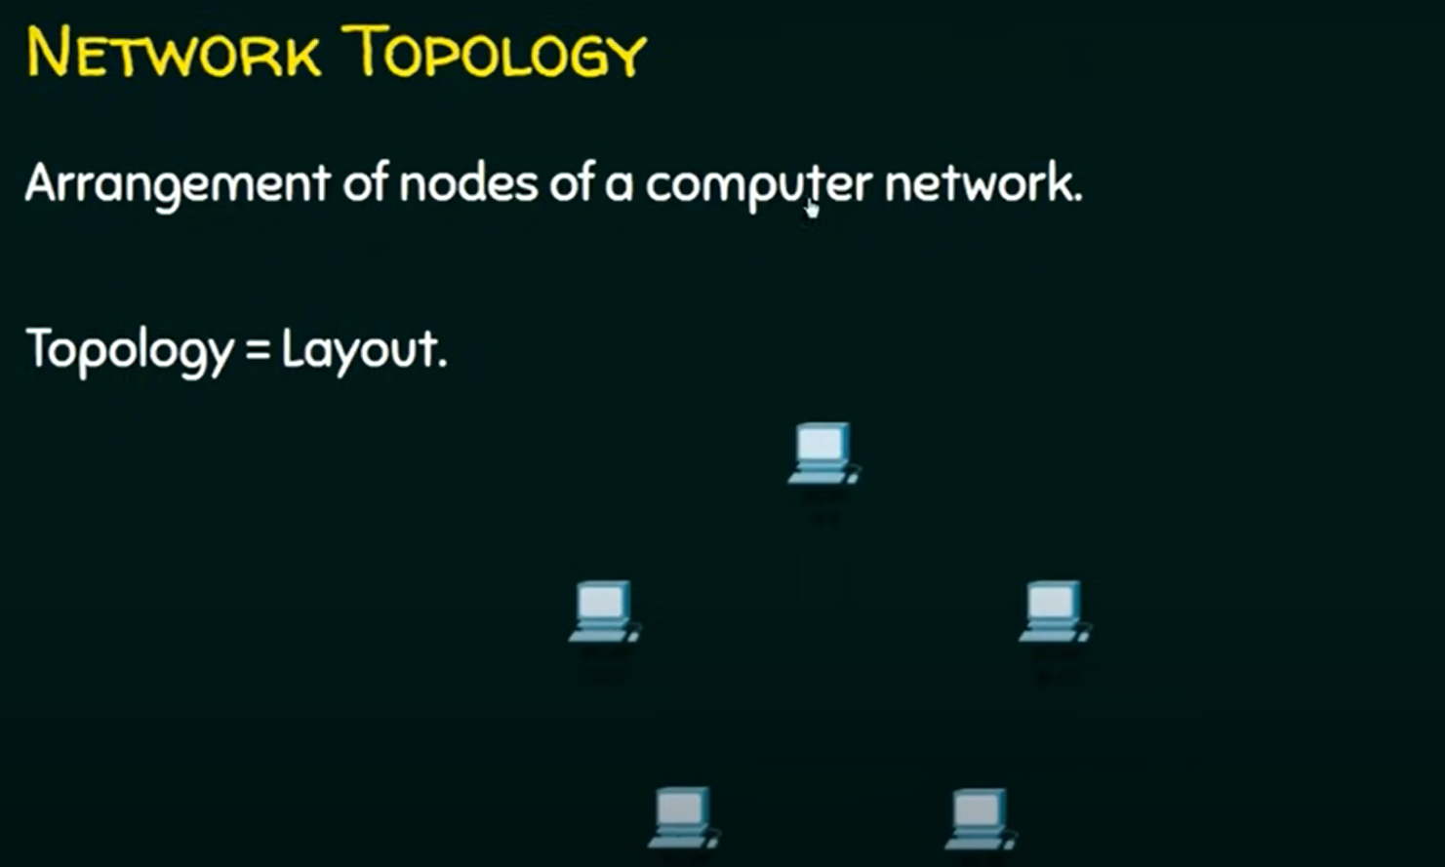

Slide 4
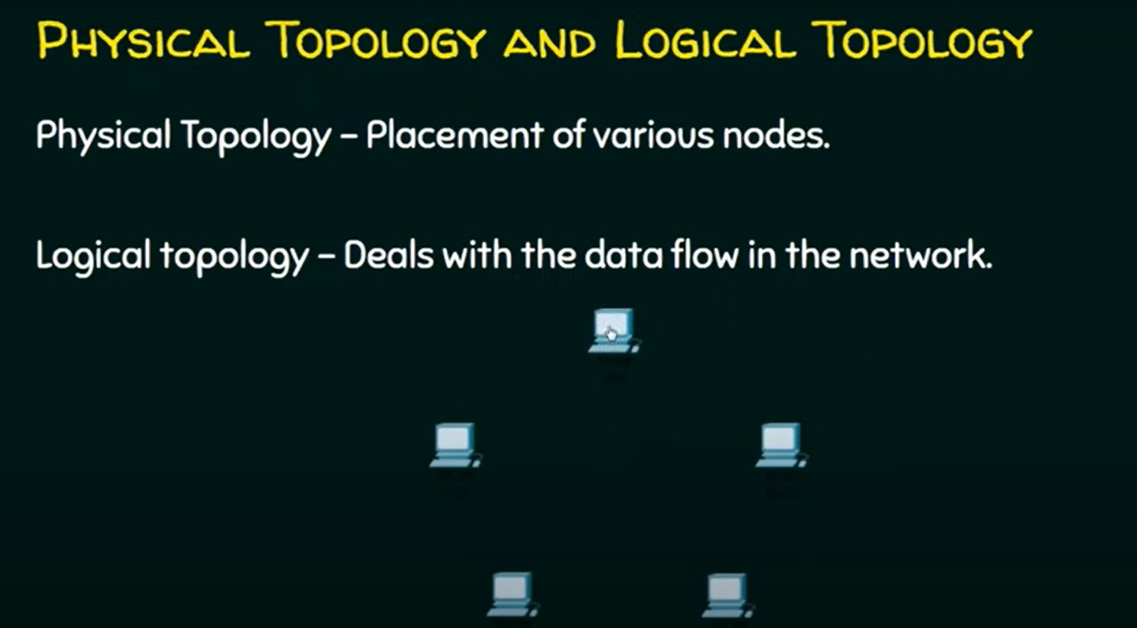

Slide 5
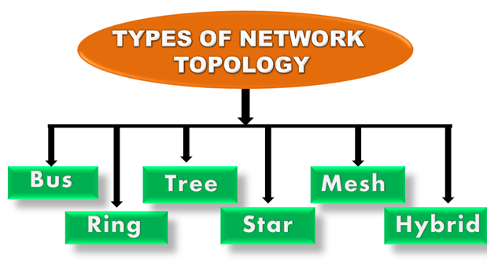

Slide 6
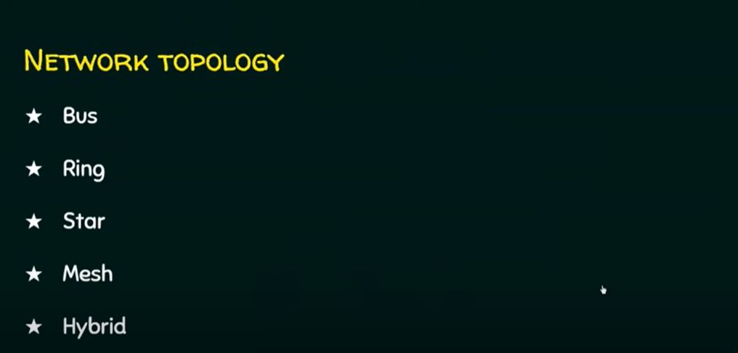

Slide 7
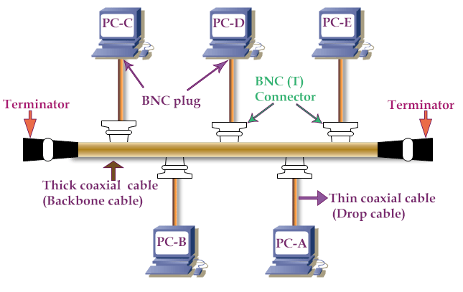

Slide 8
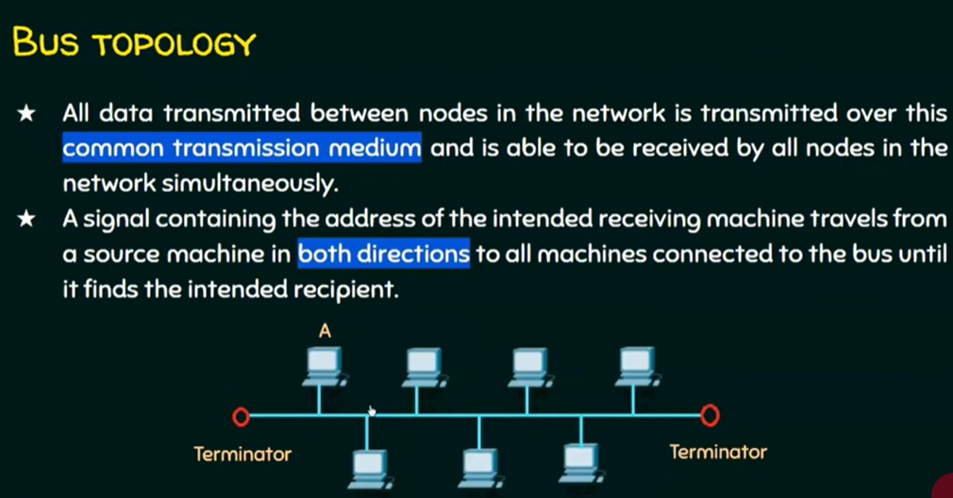

Slide 9
In this topology, all computers connect through a single continuous coaxial cable. This cable is known as the backbone cable.
Both ends of the backbone cable are terminated through the terminators. To connect a computer to the backbone cable, a drop cable is used.
To connect the drop cable to the computer and backbone cable, the BNC plug and BNC T connector are used respectively.

Slide 10
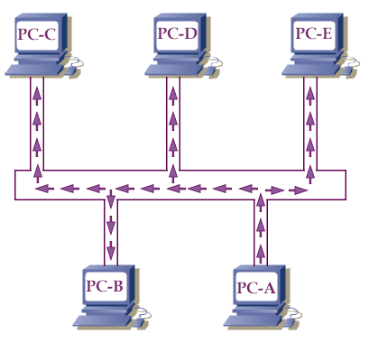
When a computer transmits data in this topology, all computers see that data over the wire, but only that computer accepts the data to which it is addressed.
It is just like an announcement that is heard by all but answered only by the person to whom the announcement is made.
For example, if in the above network, PC-A sends data to the PC-C then all computers of the network receive this data but only the PC-C accepts it. The following image shows this process.
If PC-C replies, only the PC-A accepts the return data. The following image shows this process.

Slide 11
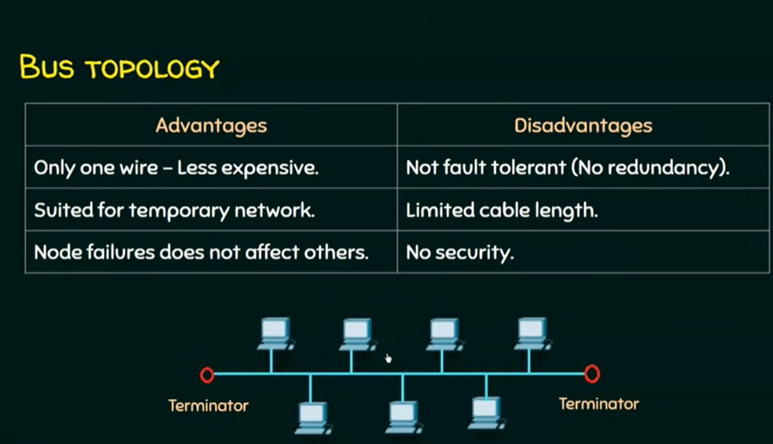

Slide 12
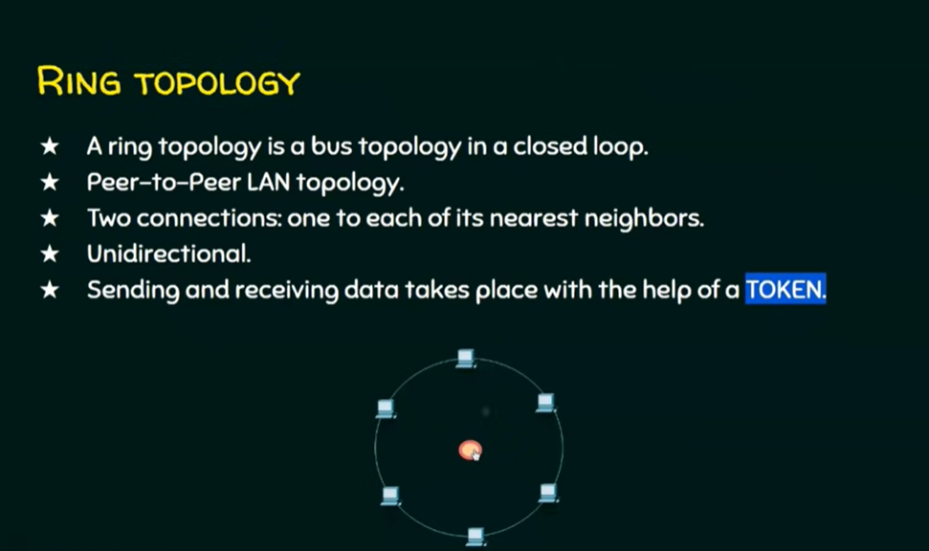

Slide 13
In this topology, all computers connect in a circle. Each computer directly connects to two other computers in the network.
Data moves down a one-way path from one computer to another. When data signals pass from one computer to the next, each computer regenerates the signals.
Since the signals are regenerated on each passing computer, the quality of the signals remains constant throughout the ring.

Slide 14
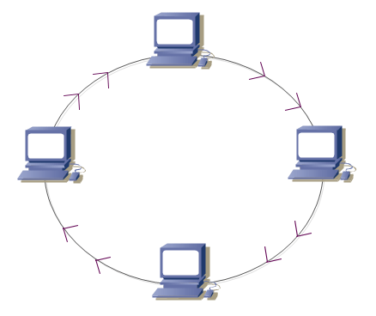

Slide 15
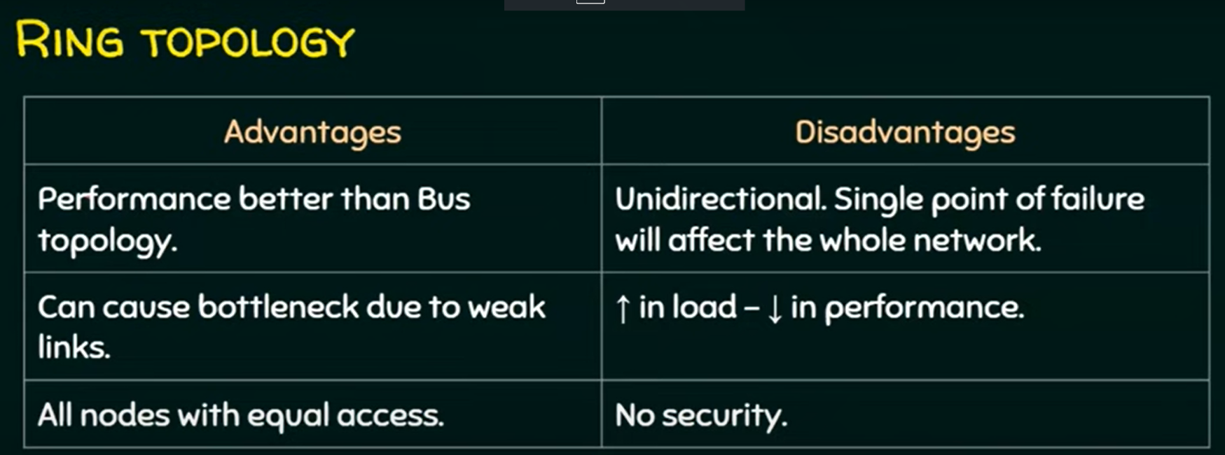

Slide 16
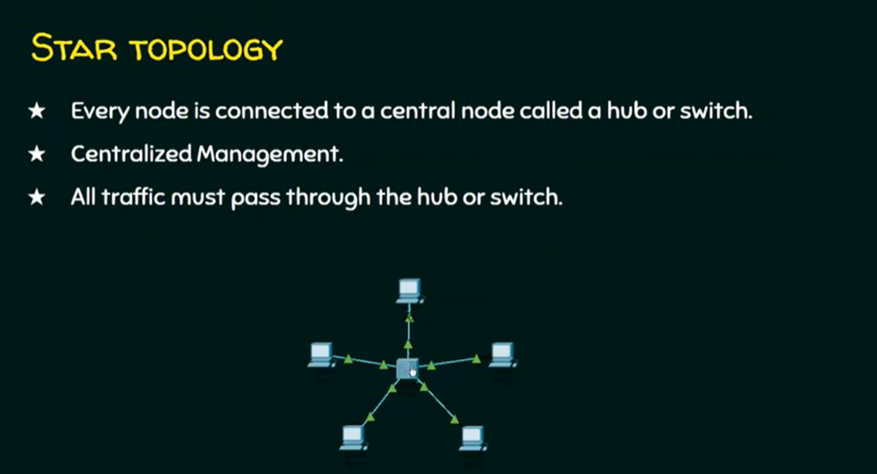

Slide 17
In this topology, all computers connect to a centralized networking device.
Usually, a networking switch or a Hub (in earlier days) is used as the centralized device.
Each computer in the network uses its own separate twisted pair cable to connect to the switch.
The twisted-pair cable uses RJ-45 connectors on both ends.

Slide 18
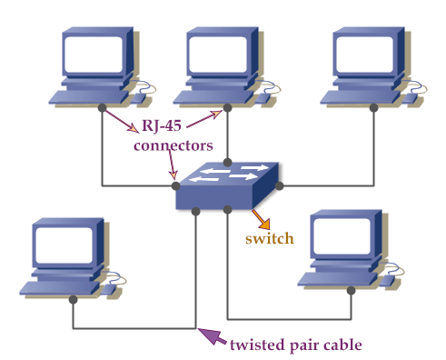

Slide 19
To transmit data, the star topology uses the same concept which the bus topology uses.
It means, if you build a network using the star topology, then that network will use the bus topology to transmit the data.
In modern computer networks, the star topology is the king. Nearly all new network installations, including small home and office networks, use some form of star topology.

Slide 20
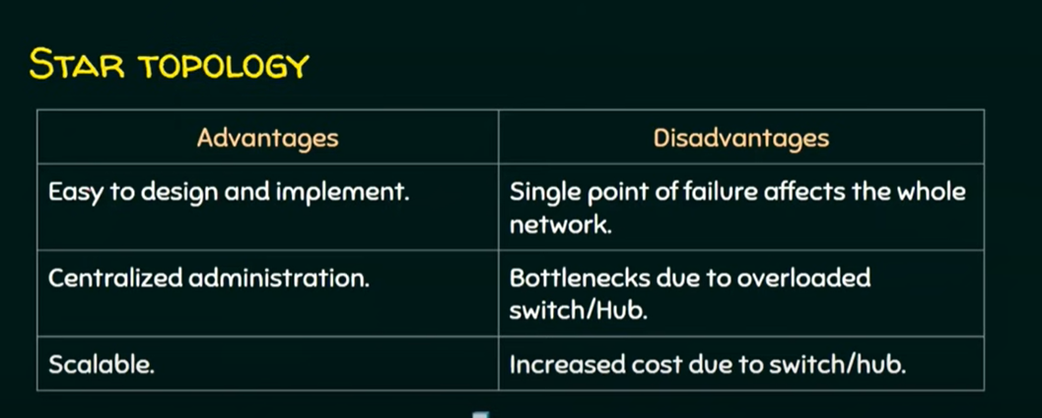

Slide 21
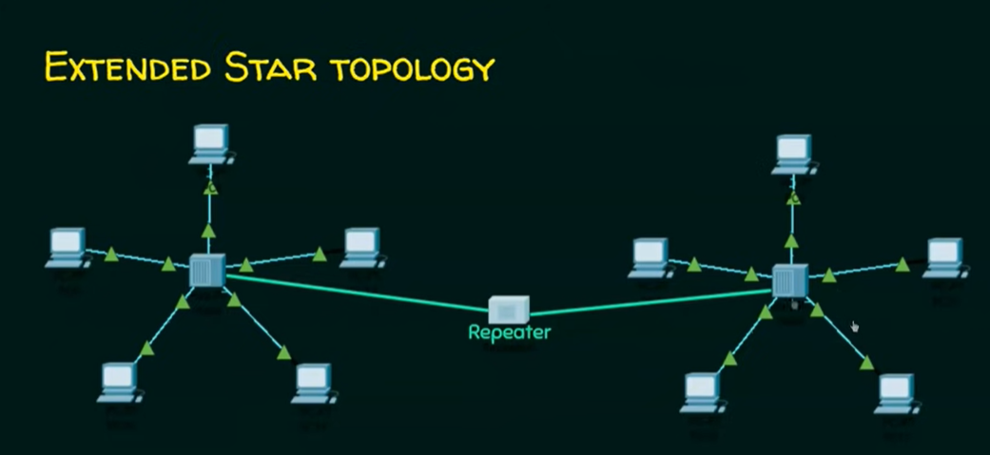

Slide 22
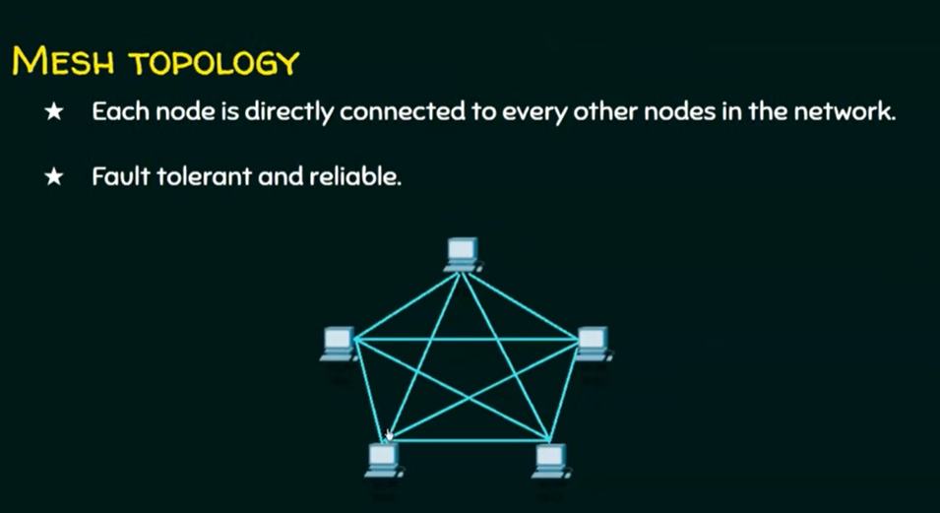

Slide 23
In this topology, multiple paths exist between end devices. Based on paths, a mesh topology can be divided into two types; fully meshed and partially meshed.
If a direct path exists from each end device to every other end device in the network, it’s a fully meshed topology.
If multiple paths exist between the end devices in the network, it’s a partially meshed topology.
Required connections = n * (n-1)/2, Here, n is the number of end devices or locations.
For example, to make a fully meshed network of 4 end devices, we need 4*(4-1)/2 = 6 connections.

Slide 24
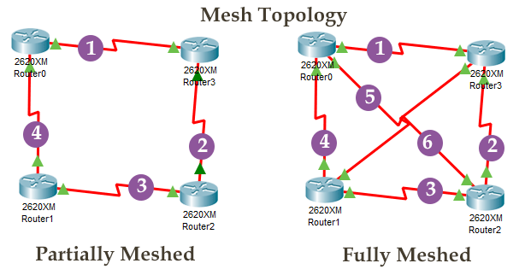
Mesh topology is commonly used in the WAN network for backup purposes. This topology is not used in the LAN network implementations.

Slide 25


Slide 26
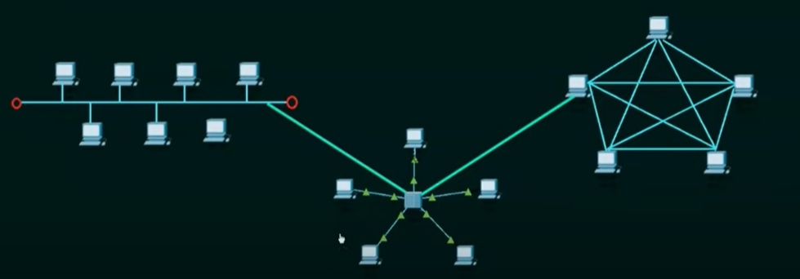
Hybrid Topology
A network structure whose design contains more than one topology is said to be hybrid topology. This topology is a mix of two or more topologies. For example, there are two networks; one is built from the star topology, and another is built from the bus topology. If we connect both networks to build a single large network, the topology of the new network will be known as the hybrid topology.

Slide 27
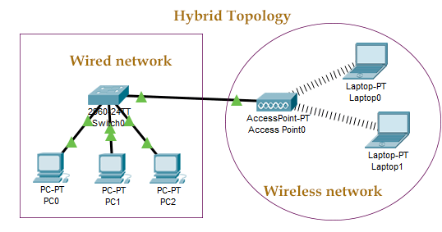

Slide 28
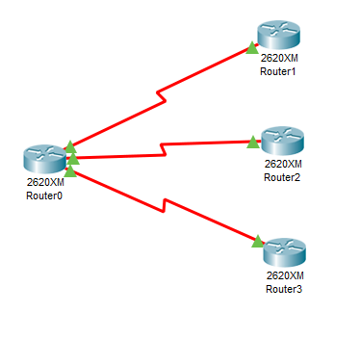
Point-to-multipoint topology
In this topology, an end device connects directly to multiple end devices in the network. Just like mesh topology, this topology is also used in the WAN network to connect multiple remote sites/locations/offices with a central site/location/office.

Slide 29
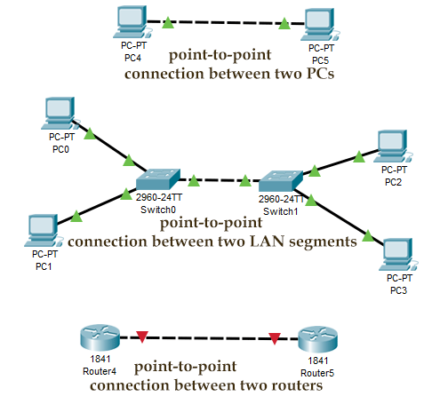
Point-to-point topology
This is the simplest form of network topology. In this topology, two end devices directly connect. The following image shows a few examples of this topology.

Slide 30
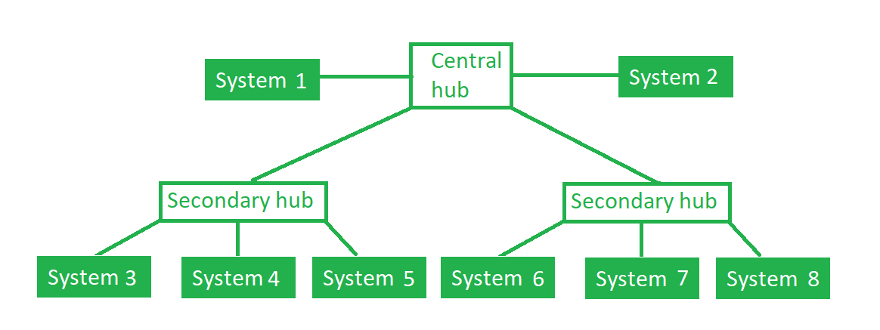
Tree Topology :
This topology is the variation of Star topology.
If the central hub gets fails the entire system fails.
The cost is high because of cabling.

